Slide 1

Caches II: Fully Associative
Assistant
Teaching Professor
Lisa Yan
Slides: PDF

Slide 2
AMAT continued

Slide 3
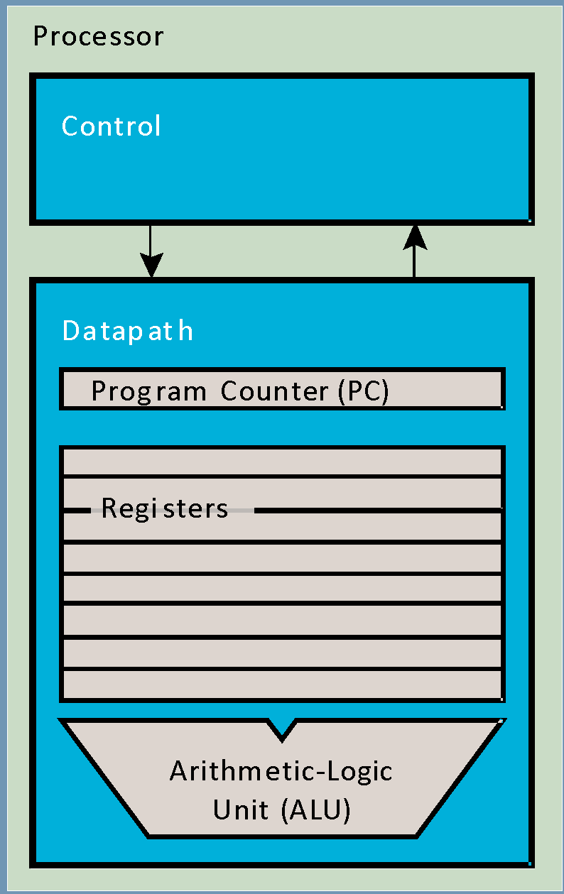
Example 1: Without L2 Cache (from before) (1/3)
Without L2 cache, assume:
  L1 Hit Time = 1 cycle
  L1 Miss rate = 5%
  L1 Miss penalty = 200 cycles
0.95
0.05
H
M
Miss Penalty
0.95 ⨉ (1)
0.05 ⨉ (1 + 200)
Hit Time
CPU
AMAT: 0.95 ⨉ 1 + 0.05 ⨉ 1 + 0.05 ⨉ 200
L1$
DRAM
w/prob. miss rate
1 + 0.05 ⨉ 200

Slide 4
Example 1: Without L2 Cache (from before) (2/3)
Without L2 cache, assume:
  L1 Hit Time = 1 cycle
  L1 Miss rate = 5%
  L1 Miss penalty = 200 cycles
0.95
0.05
H
M
Miss Penalty
0.95 ⨉ (1)
0.05 ⨉ (1 + 200)
Hit Time
CPU
AMAT: 0.95 ⨉ 1 + 0.05 ⨉ 1 + 0.05 ⨉ 200
L1$
DRAM
w/prob. miss rate
1 + 0.05 ⨉ 200

Slide 5
Example 1: Without L2 Cache (from before) (3/3)
Without L2 cache, assume:
  L1 Hit Time = 1 cycle
  L1 Miss rate = 5%
  L1 Miss penalty = 200 cycles
AMAT
= L1 hit time
+ (L1 Miss rate) * (L1 Miss Penalty)
= 1 + 0.05 x 200
= 11 cycles
Average Memory Access Time:
Miss Penalty
Hit Time
CPU
L1$
DRAM
w/prob. miss rate
Hit Time is counted both on cache hit and on cache miss.

Slide 6
Average Memory Access Time: Recursive Formula (1/2)
L2 Hit Time
Miss Penalty
Hit Time
CPU
L1$
L2$
DRAM
w/prob. L1 miss rate
w/prob. L2 miss rate
Average Memory Access Time

Slide 7

Average Memory Access Time: Recursive Formula (2/2)
L2 Hit Time
Miss Penalty
Hit Time
CPU
L1$
L2$
DRAM
w/prob. L1 miss rate
w/prob. L2 miss rate
Average Memory Access Time
recursive

Slide 8
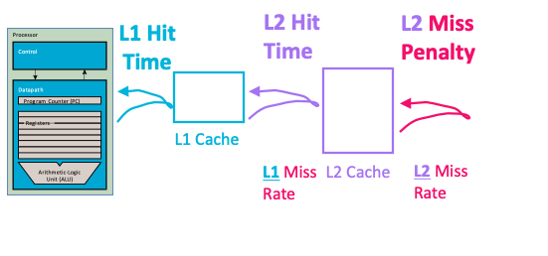
Example 2: With L2 Cache
With L2 cache, assume:
  L1 Hit Time = 1 cycle
  L1 Miss rate = 5%
  L2 Hit Time = 5 cycles
  L2 Miss rate = 15%
  L2 Miss penalty = 200 cycles
L1 (average) miss penalty
= L2 hit time
+ (L2 miss rate)*(L2 miss penalty)
= 5 + 0.15 * 200 = 35
AMAT
= L1 hit time
+ (L1 Miss rate)*(L1 miss penalty)
= 1 + 0.05 * 35
= 2.75 cycles
4x faster with L2 cache!
(2.75 vs. 11)

Slide 9
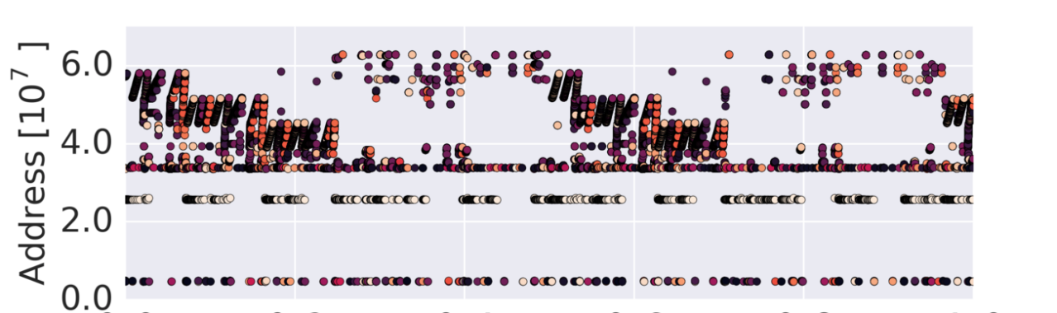
Aside: Why is the L2$ Miss Rate (usually) higher than the L1$? (1/2)
With L2 cache, assume:
  L1 Hit Time = 1 cycle
  L1 Miss rate = 5%
  L2 Hit Time = 5 cycles
  L2 Miss rate = 15%
  L2 Miss penalty = 200 cycles
Temporal Locality
If we use it now, chances are that we’ll want to use it again soon.
Spatial Locality
If we use a piece of memory, chances are we’ll use the neighboring pieces soon.
[Memory Access Patterns]
Notes:
https://csl.stanford.edu/~christos/publications/2018.mempatterns.arxiv.pdf

Slide 10
Aside: Why is the L2$ Miss Rate (usually) higher than the L1$? (2/2)
With L2 cache, assume:
  L1 Hit Time = 1 cycle
  L1 Miss rate = 5%
  L2 Hit Time = 5 cycles
  L2 Miss rate = 15%
  L2 Miss penalty = 200 cycles
Temporal Locality
If we use it now, chances are that we’ll want to use it again soon.
Spatial Locality
If we use a piece of memory, chances are we’ll use the neighboring pieces soon.
L2$ tends to receive only the “hard” memory accesses (the ones that miss in the L1$)
[Memory Access Patterns]
Notes:
https://csl.stanford.edu/~christos/publications/2018.mempatterns.arxiv.pdf

Slide 11
Cache Design

Slide 12
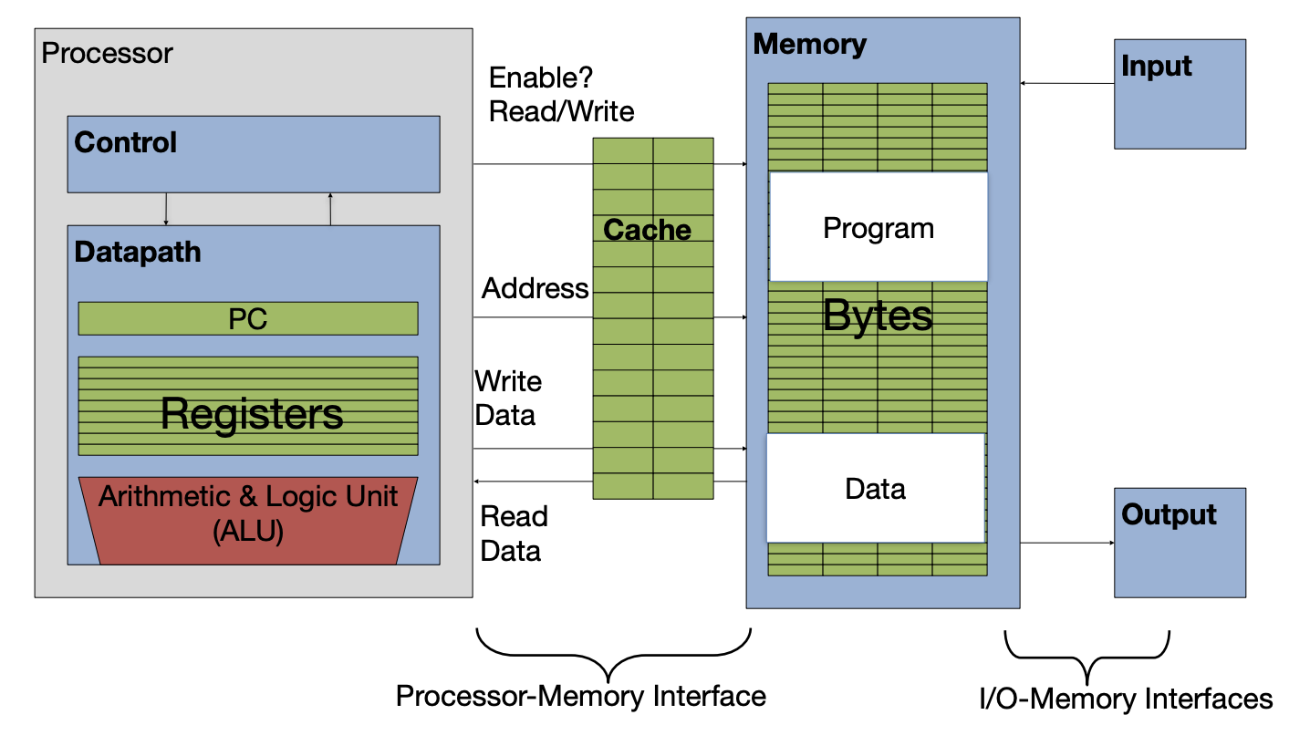
Computer with Cache
[review]
Lines (i.e., blocks) of data are copied from memory to the cache.

Slide 13
Memory Access with Cache
[review]
Load word instruction:
lw t0 0(t1)
t0
1234
Memory[0x12F0] = 1234
t1
0x12F0
Memory access with cache:
Processor issues address 0x12F0 to cache
Cache checks for copy of data, addr. 0x12F0
  If hit (finds match): cache reads 1234
  lf miss (no match): cache sends address 0x12F0 to Memory
    Memory reads 1234 @ address 0x12F0
    Memory sends 1234 to cache
    Cache replaces some line to store 1234, address 0x12F0
Cache sends 1234 to Processor
Processor loads 1234 into register t0

Slide 14
What do we need to store in the cache?
Load word instruction:
lw t0 0(t1)
t0
1234
Memory[0x12F0] = 1234
t1
0x12F0
Memory access with cache:
Processor issues address 0x12F0 to cache
Cache checks for copy of data, addr. 0x12F0
  If hit (finds match): cache reads 1234
  lf miss (no match): cache sends address 0x12F0 to Memory
    Memory reads 1234 @ address 0x12F0
    Memory sends 1234 to cache
    Cache replaces some line to store 1234, address 0x12F0
Cache sends 1234 to Processor
Processor loads 1234 into register t0
(1) Address of data
(2) Value @ address
(3) Value, accessible by byte or word

Slide 15
Cache Design: Placement Policies
Fully Associative Cache
Put a new line anywhere
(Caches II, today)
Direct Mapped Cache
Put a new line in one specific place
(Caches III)
Set-Associative Cache
(Caches IV)

Slide 16
Fully Associative Cache / Terminology

Slide 17
Terminology
Cache line/block:
  A single entry in the cache
Line size / block size:
  # bytes per cache line
Capacity
  Total # data bytes that can be stored in a cache
Tag | Data
 | 11 | 10 | 01 | 00

Slide 18
Fully Associative Cache (1/2)
Fully Associative placement policy: The data can be stored anywhere in the cache.
Tag | Data
 | 11 | 10 | 01 | 00
0x10F | … | … | … | …
0x178 | … | … | … | …
0x209 | … | … | … | …
0x149 | … | … | … | …

Slide 19
Fully Associative Cache (2/2)
Fully Associative placement policy: The data can be stored anywhere in the cache.
For a given memory address, split into two fields:
  Tag: upper bits
  Offset: byte offset within line
Tag | Data
 | 11 | 10 | 01 | 00
0x10F | … | … | … | …
0x178 | … | … | … | …
0x209 | … | … | … | …
0x149 | … | … | … | …
Load byte @ 0x43F
To check if a cache line has data at our address:
  Build tag and offset
  Check the tag
  Then, get the correct byte offset
Tag: 0x10F
Offset: 0x3

Slide 20
Fill in the blank: Fully Associative, 12b addresses
Suppose we have the below fully associative cache for 12b addresses.
A. B. C. D. E. F.
2 4 8 10 16 Other
2 4 8 10 16 Other
2 4 8 10 16 Other
2 4 8 10 16 Other
What is the line size / block size, in bytes?
What is the capacity,
in bytes?
For a 12b address, how many bits is the byte offset?
For a 12b address, how many bits is the tag?
Valid | Tag | Data
 |  | 11 | 10 | 01 | 00

Slide 21
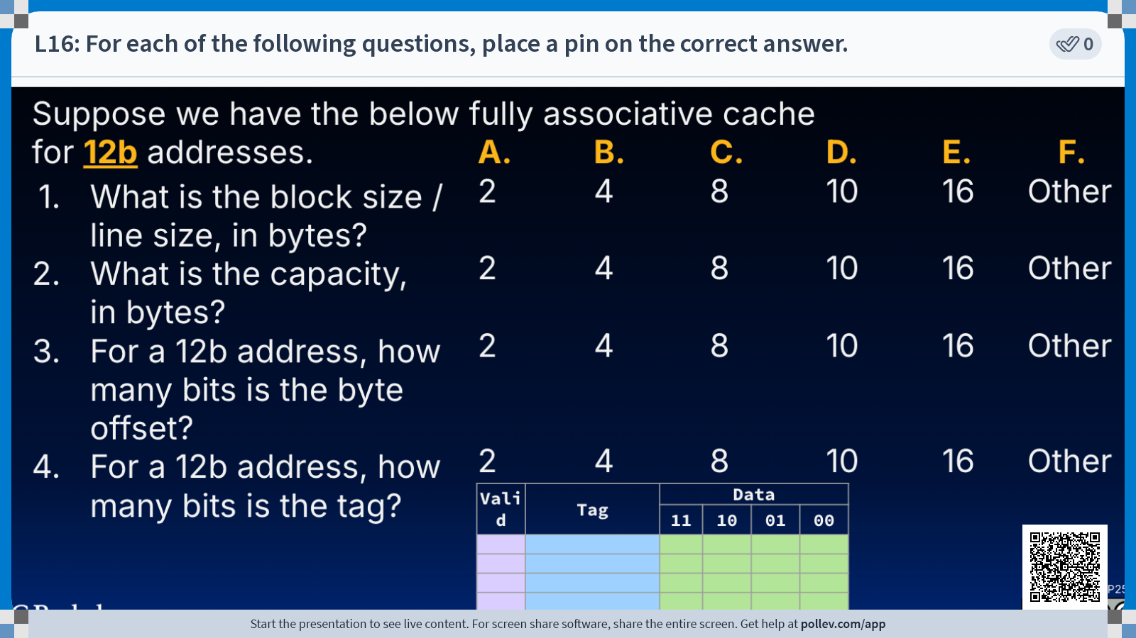

Slide 22
Terminology for Fully Associative, 12b addresses
1. Line size / block size:
  # bytes per cache line
2. Capacity
  Total # data bytes that can be stored in a cache
3. Offset
  Identifies byte address of data stored at a given cache line
4. Tag
  Identifies data stored at a given cache line
Tag | Data
 | 11 | 10 | 01 | 00
4 bytes
4 x 4 bytes
= 16 bytes
Memory address
11 2 | 1 0
tag
offset
(i.e., byte offset)
log₂(line size) = 2 bits
# address bits - # offset bits = 10 bits

Slide 23
Summary: Terminology
Cache line (i.e., cache) block
  The smallest unit of memory that can be transferred between the main memory and the cache
  Each line has its own entry in the cache
Line size/block size
  The number of bytes in each cache line
  When we bring data from the main memory into the cache, it is done in the granularity of a cache line (or cache block)
  This helps us take advantage of spatial locality
  Apple M1: 64B cache lines in L1 (usual), 128B lines in L2 [GoFetch]
Capacity
  The total number of data bytes that can be stored in a cache
  For fully associative cache, capacity = # lines * line size

Slide 24
Summary: Terminology
[reference]
Cache line/block:
  A single entry in the cache
Line size / block size:
  # bytes per cache line
Capacity
  Total # data bytes that can be stored in a cache
Offset
  Identifies byte address of data stored at a given cache line
Tag
  Identifies data stored at a given cache line (based off memory address)
Tag | Data
 | 11 | 10 | 01 | 00
Memory address
tag
offset
(i.e., byte offset)

Slide 25
Warming up the Fully Associative Cache

Slide 26
Valid Bit
When starting up a program, the cache necessarily does not have valid information for the program.
We therefore need an indicator (i.e., flag) to tell if each entry is valid for this particular program.
  Valid bit: Indicates if data stored at a cache line is valid
  1 = valid, 0 = invalid
Valid | Tag | Data
 |  | 11 | 10 | 01 | 00
0 | … | … | … | … | …
0 | … | … | … | … | …
0 | … | … | … | … | …
0 | … | … | … | … | …

Slide 27
Cache Temperatures
Cold
  Cache empty
Warming
  Cache filling with values you’ll hopefully be accessing again soon
Warm
  Cache is doing its job, fair % of hits
Hot
  Cache is doing very well, high % of hits
Our goal for cache design is temporal and spatial locality for a range of workloads!

Slide 28
Warming up the Fully Associative Cache (1/6)
Suppose the cache starts cold.
Load byte 0x43F
Valid | Tag | Data
 |  | 11 | 10 | 01 | 00
0 | … | … | … | … | …
0 | … | … | … | … | …
0 | … | … | … | … | …
0 | … | … | … | … | …
0x10F,0x3
0b0100 0011 1111
tag
offset
Cache miss! Tag 0x10F is not valid.

Slide 29
Warming up the Fully Associative Cache (1/6)
Suppose the cache starts cold.
Load byte 0x43F
Valid | Tag | Data
 |  | 11 | 10 | 01 | 00
0 | … | … | … | … | …
0 | … | … | … | … | …
0 | … | … | … | … | …
0 | … | … | … | … | …
0x10F,0x3
1 | 0x10F | … | … | … | …
0b0100 0011 1111
tag
offset
Cache miss! Tag 0x10F is not valid.
0b0100 0011 1100 ← 0x43C
0b0100 0011 1111 ← 0x43F
b. Load into cache the 4-byte line
from 0x43C to 0x43F.
Mark valid bit.
Spatial locality: Even if we only read in one byte, loading from memory will load the full line (here, 4B) associated with a tag.

Slide 30
Warming up the Fully Associative Cache (2/6)
Suppose the cache starts cold.
Load byte 0x43F 0x10F,0x3
Valid | Tag | Data
 |  | 11 | 10 | 01 | 00
0 | … | … | … | … | …
0 | … | … | … | … | …
0 | … | … | … | … | …
0 | … | … | … | … | …
1 | 0x10F | … | … | … | …
0b0100 0011 1111
tag
offset
Cache miss! Tag 0x10F is not valid.
Load into cache the 4-byte line from 0x43C to 0x43F.
Mark valid bit.
0b0100 0011 1100 ← 0x43C
0b0100 0011 1111 ← 0x43F
Spatial locality: Even if we only read in one byte, loading from memory will load the full line (here, 4B) associated with a tag.
c. Read byte at 0x3 offset
and return to processor.

Slide 31
Warming up the Fully Associative Cache (2/6)
Suppose the cache starts cold.
Load byte 0x43F 0x10F,0x3
Load byte 0x5E2 0x178,0x2
Valid | Tag | Data
 |  | 11 | 10 | 01 | 00
1 | 0x10F | … | … | … | …
0 | … | … | … | … | …
0 | … | … | … | … | …
0 | … | … | … | … | …
1 | 0x178 | … | … | … | …
0b0101 1110 0010
tag
offset
Cache miss! Tag 0x178 is not valid.
0b0101 1110 0000 ← 0x5E0
0b0101 1110 0011 ← 0x5E3
b. Load into cache the 4-byte line
from 0x5E0 to 0x5E3.
Mark valid bit.
c. Read byte at 0x2 offset
and return to processor.

Slide 32
Warming up the Fully Associative Cache (2/6)
Suppose the cache starts cold.
Load byte 0x43F 0x10F,0x3
Load byte 0x5E2 0x178,0x2
Load word 0x824 0x209,0x0
Valid | Tag | Data
 |  | 11 | 10 | 01 | 00
1 | 0x10F | … | … | … | …
1 | 0x178 | … | … | … | …
0 | … | … | … | … | …
0 | … | … | … | … | …
1 | 0x209 | … | … | … | …
0b1000 0010 0100
Cache miss! Tag 0x209 is not valid.
b. Load into cache the 4-byte line
from 0x824 to 0x827.
Mark valid bit.
c. Read word at 0x0 offset
and return to processor.

Slide 33
Warming up the Fully Associative Cache (2/6)
Suppose the cache starts cold.
Load byte 0x43F 0x10F,0x3
Load byte 0x5E2 0x178,0x2
Load word 0x824 0x209,0x0
Load byte 0x5E0 0x178,0x0
Valid | Tag | Data
 |  | 11 | 10 | 01 | 00
1 | 0x10F | … | … | … | …
1 | 0x178 | … | … | … | …
1 | 0x209 | … | … | … | …
0 | … | … | … | … | …
0b0101 1110 0000
tag
offset
Cache hit! Tag 0x178 is valid.
Read byte at 0x0 offset and return to processor.
On a cache hit, no memory access occurs!

Slide 34
Hardware: Fully Associative Cache
(more later)
A Fully Associative Cache must compare tags in parallel:
31
4
0
Cache Tag (27 bits long)
Byte Offset
Cache Tag
Valid
Cache Data
:
=
B 15
B 1
B 0
=
=
=
:
:
:
:
=
Fully Associative: Any line can potentially match our tag. Need to check all tags in our cache!
Notes:
Consider adjusting this to the caches III

Slide 35
Line Replacement Policies

Slide 36
A Warmed up Cache Can Still Miss
By the end of instr 5, cache is warm.
Load byte 0x43F 0x10F,0x3
Load byte 0x5E2 0x178,0x2
Load word 0x824 0x209,0x0
Load byte 0x5E0 0x178,0x0
Load word 0x524 0x149,0x0
Valid | Tag | Data
 |  | 11 | 10 | 01 | 00
1 | 0x25C | … | … | … | …
1 | 0x178 | … | … | … | …
1 | 0x209 | … | … | … | …
0 | … | … | … | … | …
1 | 0x149 | … | … | … | …
Fills up the cache

Slide 37
A Warmed up Cache Can Still Miss
By the end of instr 5, cache is warm.
Load byte 0x43F 0x10F,0x3
Load byte 0x5E2 0x178,0x2
Load word 0x824 0x209,0x0
Load byte 0x5E0 0x178,0x0
Load word 0x524 0x149,0x0
Load byte 0x972 0x25C,0x2
Valid | Tag | Data
 |  | 11 | 10 | 01 | 00
1 | 0x25C | … | … | … | …
1 | 0x178 | … | … | … | …
1 | 0x209 | … | … | … | …
1 | 0x149 | … | … | … | …
When the FA cache reaches capacity, we can still miss.
We need a policy for line replacement!
0b1001 0111 0010
Cache miss!

Slide 38
Line Replacement Policies (i.e., Eviction)
Least Recently Used (LRU)
  Replace the entry that has not been
  used for the longest time,
  i.e., has the oldest previous access.
  Pro: Temporal locality!
    recent past use implies likely future use
  Con: Complicated hardware to keep track of access history

Slide 39
Fully Associative Cache with LRU policy
By the end of instr 5, cache is warm.
Load byte 0x43F 0x10F,0x3
Load byte 0x5E2 0x178,0x2
Load word 0x824 0x209,0x0
Load word 0x5E0 0x178,0x0
Load word 0x524 0x149,0x0
Load byte 0x972 0x25C,0x2
Valid | LRU | Tag | Data
 |  |  | 11 | 10 | 01 | 00
1 |  | 0x10F | … | … | … | …
1 |  | 0x178 | … | … | … | …
1 |  | 0x209 | … | … | … | …
1 |  | 0x149 | … | … | … | …
LRU
0
1
2
3
LRU
3
2
1
0
LRU
3
1
2
0
LRU
0
2
3
1
Suppose that LRU = 0 means most recently used, and 3 means least recently used.
After the end of instruction 5, what are the LRU tags on each row?
A.
B.
C.
D.

Slide 40
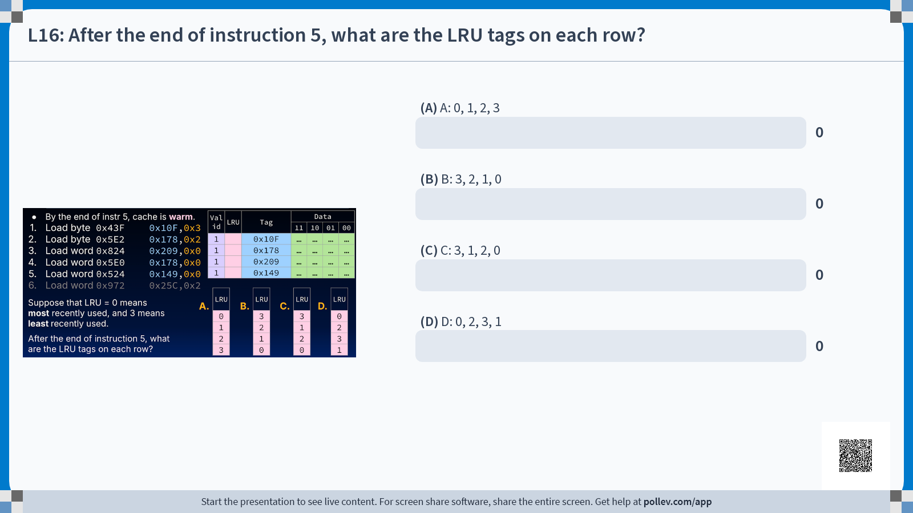

Slide 41
Fully Associative Cache with LRU policy
By the end of instr 5, cache is warm.
Load byte 0x43F 0x10F,0x3
Load byte 0x5E2 0x178,0x2
Load word 0x824 0x209,0x0
Load word 0x5E0 0x178,0x0
Load word 0x524 0x149,0x0
Load byte 0x972 0x25C,0x2
Valid | LRU | Tag | Data
 |  |  | 11 | 10 | 01 | 00
1 |  | 0x25C | … | … | … | …
1 |  | 0x178 | … | … | … | …
1 |  | 0x209 | … | … | … | …
1 |  | 0x149 | … | … | … | …
Valid | LRU | Tag
1 | 0 | 0x10F
0
0
0
Valid | LRU | Tag
1 | 1 | 0x10F
1 | 0 | 0x178
0
0
Valid | LRU | Tag
1 | 2 | 0x10F
1 | 1 | 0x178
1 | 0 | 0x209
0
Valid | LRU | Tag
1 | 2 | 0x10F
1 | 0 | 0x178
1 | 1 | 0x209
0
Valid | LRU | Tag
1 | 3 | 0x10F
1 | 1 | 0x178
1 | 2 | 0x209
1 | 0 | 0x149
Suppose that LRU = 0 means most recently used, and 3 means least recently used.
After the end of instruction 5, what are the LRU tags on each row?

Slide 42
A Warmed up Cache Can Still Miss
By the end of instr 5, cache is warm.
Load byte 0x43F 0x10F,0x3
Load byte 0x5E2 0x178,0x2
Load word 0x824 0x209,0x0
Load word 0x5E0 0x178,0x0
Load word 0x524 0x149,0x0
Load byte 0x972 0x25C,0x2
Valid | LRU | Tag | Data
 |  |  | 11 | 10 | 01 | 00
1 | 3 | 0x10F | … | … | … | …
1 | 1 | 0x178 | … | … | … | …
1 | 2 | 0x209 | … | … | … | …
1 | 0 | 0x149 | … | … | … | …
LRU | Tag
0 | 0x25C
2 | 0x178
3 | 0x209
1 | 0x149
… | … | … | …
Cache miss!
Load into cache the 4-byte line from 0x970 to 0x973. Mark valid bit. Update line replacement policy fields (e.g., LRU).r.
c. Read byte at 0x2 offset, return to processor.

Slide 43
Line Replacement Policies (i.e., Eviction)
Least Recently Used (LRU)
  Replace the entry that has not been
  used for the longest time,
  i.e., has the oldest previous access.
  Pro: Temporal locality!
    recent past use implies likely future use
  Con: Complicated hardware to keep track of access history
Most Recently Used (MRU)
  Replace the entry that has the newest previous access.
First In, First Out (FIFO)
  Replace the oldest line in the set (queue).
Last In, First Out (LIFO)
  Replace the newest line in the set (stack).
Random
LRU is ideal for temporal locality. In practice, FIFO/LIFO/Random the most common.
Reasonable approximations to LRU, MRU without adding too much excess hardware.
Works surprisingly okay (when given a low temporal locality workload)

Slide 44
[if time] Write Policies

Slide 45
What about Stores?
By the end of instr 5, cache is warm.
Load byte 0x43F 0x10F,0x3
Load byte 0x5E2 0x178,0x2
Load word 0x824 0x209,0x0
Load word 0x5E0 0x178,0x0
Load word 0x524 0x149,0x0
Load byte 0x972 0x25C,0x2
Store byte 0x524 0x149,0x0
Valid | LRU | Tag | Data
 |  |  | 11 | 10 | 01 | 00
1 | 0 | 0x25C | … | … | … | …
1 | 2 | 0x178 | … | … | … | …
1 | 3 | 0x209 | … | … | … | …
1 | 1 | 0x149 | … | … | … | …
Cache hit! …and then?
How to handle stores?

Slide 46
Write-through vs. Write-back Policies
Store instructions write to memory, which changes values.
Hardware needs to ensure that cache and memory have consistent information.
Valid | LRU | Tag | Data
 |  |  | 11 | 10 | 01 | 00
1 | 0 | 0x25C | … | … | … | …
1 | 2 | 0x178 | … | … | … | …
1 | 3 | 0x209 | … | … | … | …
1 | 1 | 0x149 | … | … | … | …
Write policies have tradeoffs:
Store byte 0x524(0x149,0x0)
Write-through:
  Write to the cache and memory at the same time.
  (more writes to memory → longer AMAT)
Write-back:
  Write data in cache and set a dirty bit to 1.
  When this line gets evicted from the cache
  (and “back” to memory), write to memory.
simple to implement
(typically) lower traffic to memory

Slide 47
Fully Associative Cache w/ LRU, Write-Back
Write-back:
  Write data in cache and set a dirty bit to 1.
  When this line gets evicted from the cache
  (and “back” to memory), write to memory.
Valid | Dirty | LRU | Tag | Data
 |  |  |  | 11 | 10 | 01 | 00
1 | 0 | 0 | 0x25C | … | … | … | …
1 | 0 | 2 | 0x178 | … | … | … | …
1 | 0 | 3 | 0x209 | … | … | … | …
1 | 1 | 1 | 0x149 | … | … | … | …
Store byte 0x524(0x149,0x0)
Cache hit w/write-back:
update cache line, and wait until this line is evicted before writing back to memory

